Slide 1
How Chrome 142 broke single sign on
Robert Gemrot

Slide 2
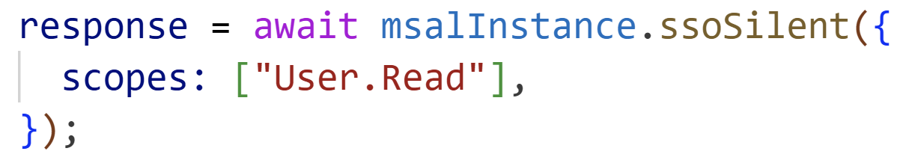
Context
Broken autologin out of nowhere
@azure/msal-browser
  ssoSilent (docs)
DEMO

Slide 3
Diagnostic
BrowserAuthError: monitor_window_timeout: Token acquisition in iframe failed due to timeout
CORS error
  Maybe missing Access-Control-Allow-Origin?
Need to dig deeper

Slide 4
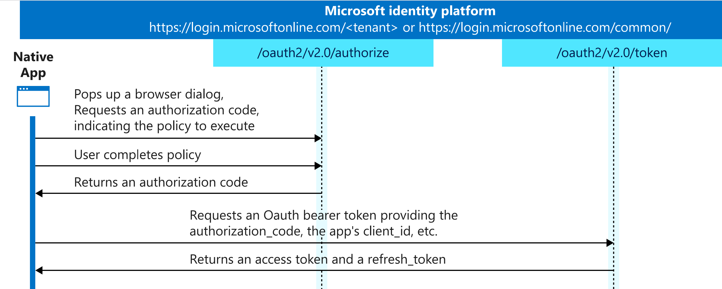
OAuth2 Authorization Code flow
https://learn.microsoft.com/en-us/entra/identity-platform/media/v2-oauth2-auth-code-flow/convergence-scenarios-native.svg

Slide 5
The iframe
ssoSilent creates a hidden iframe
iframe loads login.microsoftonline.com/…/authorize
  Redirect to localhost/login-landing.html
ssoSilent polls for the iframe URL
  Or times out
If successful, ssoSilent extracts the code and calls /token

Slide 6
Local network access restrictions
New browser feature
  Default ON in Chrome v142
Public websites cannot access local network
  login.microsoftonline.com resolves to a public IP
  localhost is local network
  Browser blocks the request
User prompt?
  Only if iframe is allowed
  allow="local-network-access *"

Slide 7
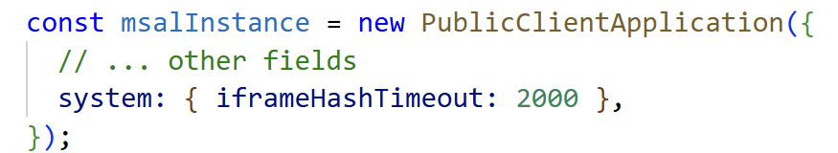
How to solve?
Lower the timeout
Wait for upstream fix
  https://github.com/AzureAD/microsoft-authentication-library-for-js/issues/8100
  https://github.com/AzureAD/microsoft-authentication-library-for-js/pull/8132

Slide 8
Fishy Chrome mystery
First vs. Second request behave differetly
First:
  Reset settings to Chrome defaults
  Correct redirect to localhost/login-landing.html
  Browser blocks
  Timeout kicks in
Second
  …
  Browser ALLOWS – why? How?

Slide 9

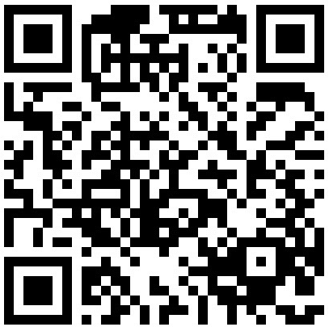
Robert Gemrot
github.com/fejbl2/lectures
linkedin.com/in/robert-gemrot

